Slide 1
Algae and Climate Change
Susan S. Kilham
Department of Biodiversity, Earth & Environmental Science
Drexel University

Slide 2

Climate change is happening at unprecedented rates
Increasing CO₂. Now more than 400 ppm
Increasing ocean acidification
Increasing temperatures, especially in the Arctic
Sea level rise
Stratification changes
Increasing habitat loss
Other anthropogenic changes (e.g., toxic chemicals)

Slide 3
My personal journey to awareness of climate impacts
Early interest in affects of temperature on growth rates and nutrient utilization of algae, especially diatoms (Mechling and Kilham. 1982. J. Phycol. 18: 199-205; van Donk and Kilham. 1990. J. Phycol. 26: 40-50.)
Natural phytoplankton community experiments along Si:P ratio gradients at two temperatures showed communities dominated over a wider range by diatoms at 9ᵒC and more by green algae at 15ᵒC (Tilman, Kiesling, Sterner, Kilham, and Johnson. 1986. Arch. Hydrobiol.106: 473-485.)
Research on phytoplankton in the large lakes of the Greater Yellowstone Ecosystem (GYE) with Edward Theriot and Sebastian Interlandi

Slide 4
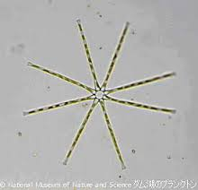
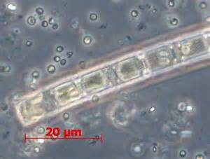
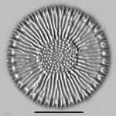
Generalizations about major diatoms species in GYE
Asterionella formosa: needs high Si, moderate N, favored by early stratification and warm epilimnion
Aulacosira subarctica: low light specialist, favored by deep mixing, low nutrients, early stratification
Cyclotella bodanica: grows under low-N, usually in late summer, favored by low precipitation years

Slide 5
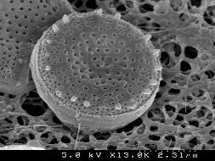
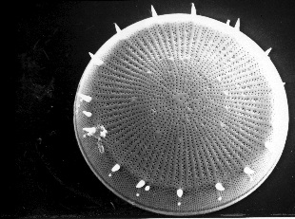
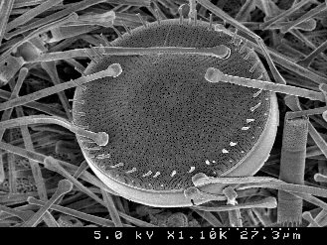
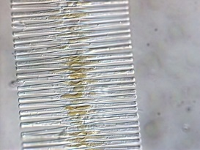
Generalizations about major diatoms species in GYE
Stephanodiscus minutulus: grows well under ice, best competitor for Si, grow rapidly under high nutrients because of small size
Stephanodiscus yellowstonensis: grows best in drought years, local maxima in metalimnion, better than S. niagarae under N-limitation
Stephanodiscus niagarae: needs moderate N & P, does better in high precipitation years and grows well under low light (not in Yellowstone L.)
Fragilaria crotonensis: rare in Yellowstone Lake, requires high N, moderate Si, good competitor for P (grows best in Lewis Lake which is most P-limited

Slide 6
C:N, C:P, C:Si and N:P ratios
with depth during the growing season in Lewis, Jackson and Yellowstone lakes
4 potentially limiting resources: N, P, Si, light
Sampled every week during the growing season, every 5 m from 0 to 25 or 50m
Enumerated algae by biovolume
Interlandi, Kilham & Theriot, 1999. Limnol. Oceanogr. 44: 668-682

Slide 7
Abundance by biovolume of most abundant diatoms over the growing season
The point of maximum abundance of each species
was distinct and varied according to the 4-part ratio
Interlandi, Kilham & Theriot, 1999. Limnol. Oceanogr. 44: 668-682

Slide 8
Diversity of planktonic algae
Threshold levels for limitation
0.85 x µmax for least efficient species
P: 0.32 µmol/L
N: 3.0 µmol/L
Si: 139 µmol/L
Light 150 W/m²
Interlandi & Kilham, 2001. Ecology 82:1270-1282

Slide 9
Impacts of El Niño in GYE
Winter precipitation lower and therefore N-loading lower (lower N:P)
Total diatom biomass lower in Yellowstone and Jackson lakes
Si concentrations higher because of lower diatom demand (higher Si:P)
Predictable changes in phytoplankton community structure because of changes in ratio gradients

Slide 10
Impacts of El Niño in GYE
Early ice off and earlier stratification (higher Light:N)
Shallower epilimnion (depends on early summer storm activity)
S. yellowstonensis historically favored during drought periods
A. formosa and S. minutulus favored by high Light:N in early summer
C. bodanica favored by increased N-limitation in summer

Slide 11
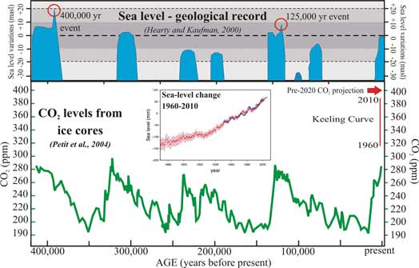
The Climate Challenge
The magnitude of climate change is remarkable: We have already exceeded the maximum CO₂ concentration. experienced in the past 740,000 yrs. and will soon exceed that experienced in tens of millions of years.

Slide 12
The Climate Challenge
The rates of abiotic change are unprecedented. The rise in CO₂ in the past 150 years is 100 to 1000 times faster than at any point in the past 420,000 yrs. and is still accelerating.
These changes pose serious challenges to species that must either acclimate, adapt, or go extinct.

Slide 13
Harris, Nixon and Duarte, 2006. Estuaries and Coasts 29: 343–347
The Impact of Temperature Rise on Respiration and Heterotrophic Metabolism
Calculated using metabolic models, a 4 ºC warming is predicted to result in a 20% increase in net primary production, but a 43% increase in oxygen consumption
Seagrass Meadows
The net effect is a decrease in biomass; also true for agricultural crops
Notes:
13

Slide 14
Major Algal Groups and Major Biological Processes in Selected Ocean Regions
NATL – North Atlantic; EPAC- Equatorial Pacific; ARC- Arctic; ANT- Antarctic; NPAC- North Pacific
Toseland et al. 2013. Nature Climate Change 3:979-984

Slide 15
Major Algal Groups and Major Biological Processes in Selected Ocean Regions
T of eukaryotic phytoplankton the density of ribosomes to make protein. P rich ribosomes in warmer oceans will result in organism N:P, N-demand. Changes in phytoplankton stoichiometry driven by T may play a critical role in resource allocation and biogeochemical cycling of major nutrients.
NATL – North Atlantic; EPAC- Equatorial Pacific; ARC- Arctic;
ANT- Antarctic; NPAC- North Pacific
Toseland et al. 2013. Nature Climate Change 3:979-984

Slide 16
Role of Metabolic Processes
Sequenced eukaryotic phytoplankton metatranscriptones
CCA analysis revealed that temperature accounts for 28.3% of metabolic variability, similar to nitrate (31.7%), phosphate (34.9%), and light (30.2%).
Translation of proteins was strongly affected by temperature.
The rate of protein synthesis in cells appears to at higher temperature which is compensated by ribosome density.
Toseland et al. 2013. Nature Climate Change 3:979-984

Slide 17
Role of Metabolic Processes
Membrane associated processes involved in ion transport, photosynthesis and respiration were significantly in the EPAC metatranscriptones.
Under low temperatures, cells invest more in biosynthesis, whereas under high temperatures more resources are invested in photosynthesis.
Toseland et al. 2013. Nature Climate Change 3:979-984

Slide 18
Balancing Physical and Metabolic Effects
Lewandowska et al. (2014) used 1500 L mesocosms (2 temps; 6 nutrient flux levels; Baltic Sea plankton) to explore the physically mediated effect of warming on stratification which indirectly affects nutrient supply rates and direct effects of warming on metabolic rates.
Lewandowska et al. 2014. Ecology Letters 17:614-623.

Slide 19
Balancing Physical and Metabolic Effects
As T :
-heterotrophic processes are more sensitive to T than autotrophic ones.
– higher grazing rates by zooplankton
–lower phytoplankton biomass
-faster recycling by bacteria which could increase phytoplankton productivity.
Lewandowska et al. 2014. Ecology Letters 17:614-623.

Slide 20
Balancing Physical and Metabolic Effects
In nutrient replete waters (a) T influences plankton mainly through metabolic changes.
Such systems are typically dominated by large diatoms.
Warming creates a growing imbalance between grazing and algal growth which reduces algal biomass.
Lewandowska et al. 2014. Ecology Letters 17:614-623.

Slide 21
Balancing Physical and Metabolic Effects
In nutrient-limited waters (b) T influences phytoplankton mainly through physical mechanisms related to stratification and nutrient supply.
Low nutrients favor small plankton and copepods switch to eating larger ciliates.
Lewandowska et al. 2014. Ecology Letters 17:614-623.

Slide 22
Changes in phytoplankton communities
Climate affects phytoplankton directly through physiology and indirectly through water column stratification and grazing (Winder and Sommer 2012. Hydrobiologia 698:5-16)
Increasing T increases growth rates under light saturating conditions

Slide 23
Changes in phytoplankton communities
Vertical mixing is a key variable because stratification affects light and nutrient availability for growth. Smaller, buoyant species have an advantage under reduced mixing.
Warming increases consumption by herbivores more strongly than primary production which strengthens top down control (Sommer and Lewandowska 2011. Global Change Bio. 17:154-162)

Slide 24
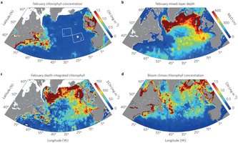
Dance of the Phytoplankton
Climate change will impact the availability of growth-limiting resources.
The biomass of phytoplankton is not proportional to their division rates.
February chlorophyll
February mixed layer depth
Feb depth integrated chl
Bloom climax chl concentration
Behrenfeld. 2014. Nature Climate Change. 4:880-892.

Slide 25
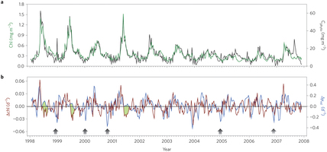
Dance of the Phytoplankton
Physical processes can trigger blooms even while division rates are decreasing. This is because changes in division rates are paralleled by proportional changes in grazing, viral attack and other loss rates.
This leads to a trophic dance between predators and prey which can result in massive blooms.
The blooming process may be
strongly modified by climate
warming , particularly at higher
latitudes.
Behrenfeld. 2014. Nature Climate Change. 4:880-892.
Green- bloom; Blue: Relative change in division rates

Slide 26
Changes in phytoplankton communities
The timing and magnitude of seasonal blooms are shifting in response to climate changes (Edwards and Richardson. 2004. Nature 430:881-884)
Dinoflagellates (eutrophic regions) and flagellates (oligotrophic regions) are favored under reduced mixing conditions and diatoms under stronger mixing

Slide 27
Changes in phytoplankton communities
Cyanobacteria have a competitive advantage over other taxa in warmer, eutrophic conditions. They have higher µ_{max} than diatoms and green algae at T above 25ᵒ. (Jöhnk at al. 2008. Global Change Biol. 14:412-495)
There are increases in harmful algal blooms under warmer, eutrophic conditions. (EPA 820-S-13-001)

Slide 28
Changes in phytoplankton communities
Under reduced mixing conditions small cells have high S/V, lower sinking rates and higher growth rates (Litchman et al. 2007 Ecol. Letters 10:1170-1181)
A shift to small-sized cells will result in lower export which has positive feedbacks on the climate system. Blooms of cyanobacteria and dinoflagellates have large ecosystem impacts on trophic transfer, water quality and fish production

Slide 29
Changes in phytoplankton communities
On geological times scales, marine diatom size structure and diversity shifted toward smaller size under warming temperature conditions (Finkel et al. 2005. PNAS doi: 10.1073/PNAS.0709381104).
In high latitude lakes, there has been an expansion of pelagic, small diatom species in recent decades probably due to a longer ice-free season and increased stratification. (Smol et al. 2005. PNAS 102:4397-4402; Rühland et al. 2008. Global Change Biol. 14: doi: 10.1111/j.1365-2486.2006.01670)

Slide 30
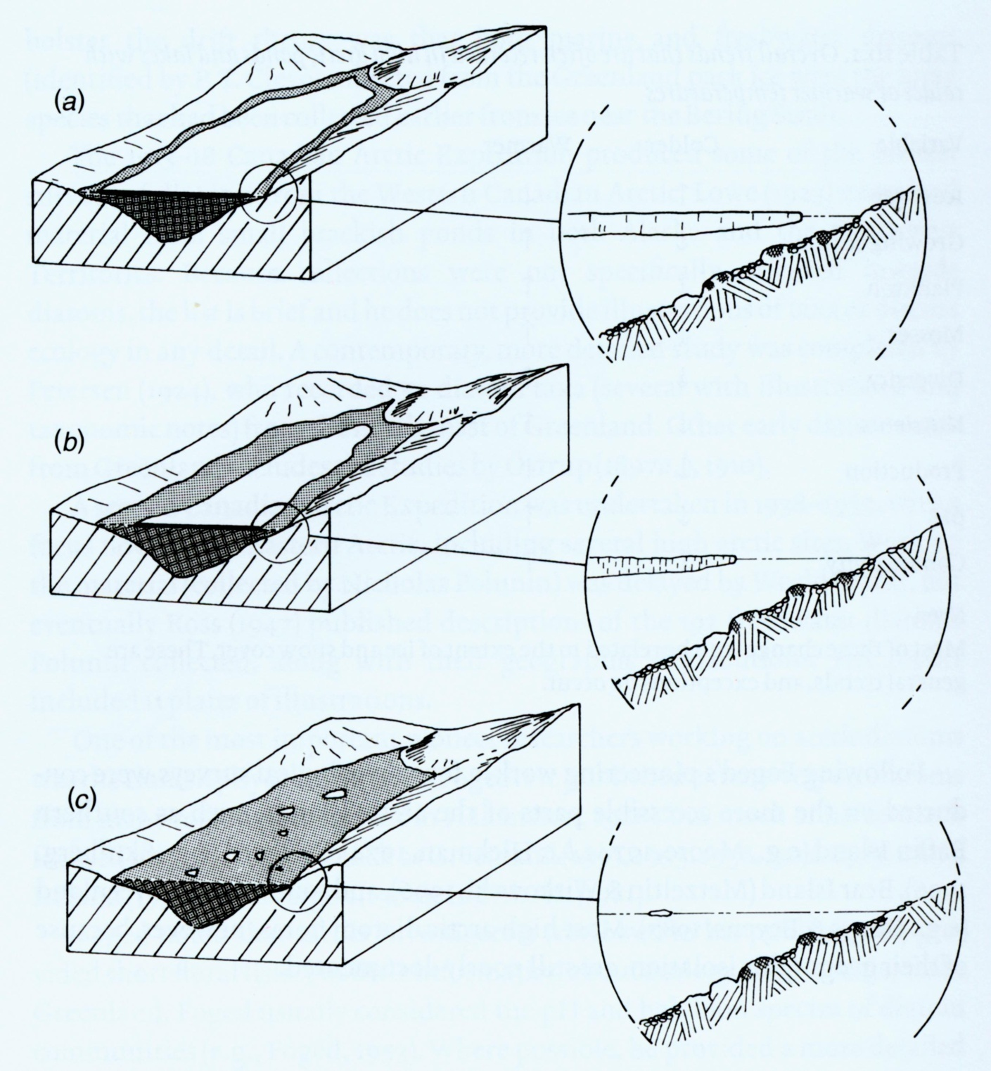
Cooler temperatures
Warmer Temperatures
(Smol 1983, 1988)
Notes:
30

Slide 31
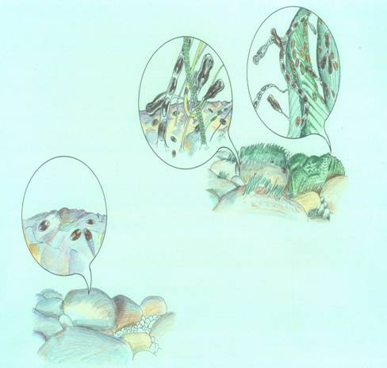
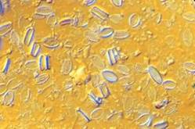
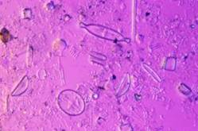
Warmer,
less ice
Colder,
extensive ice
Douglas and Smol (2010)
Notes:
As the ice-free season elongates, you would get a shift from benthic, prostrate araphed forms limited to epilithic and epipelic species to a more complex assemblage of ephiphytic tube and stalk dwelling forms including, pinnularia , cymbella and achnanthes taxa

Slide 32
Hudson Bay area has recently undergone a climate regime shift in the 1990s (Rühland et al. 2013, Proc Roy Soc Lond B)
Churchill Temperature Record: identifying thresholds
Δ -0.05°C
Δ +3.2°C
-3
Breakpoint at 1991: p<0.0001
1991
-4
-5
-6
Mean Annual Temperature (ºC)
-7
-8
-9
LOESS smoother (Span = 0.2)
-10
1940
1945
1950
1955
1960
1965
1970
1975
1980
1985
1990
1995
2000
2005
2010
Notes:
IN THE PAST 15-20 years there has been a notable shift in the climate around Hudson Bay as sea ice concentrations and sea ice phenology is rapidly changing. …THE RAPID TRANSITION OF THE REMOTE HBL FROM A REGION OF COOLING TO ONE OF INTENSIFIED WARMING PRESENTS A NATURAL TEST AREA TO DETERMINE WHAT TRIGGERS DIATOM CHANGES….
there is now a positive feedback onto the climate system that is rapidly amplifying this warming trends with the largest increase in the melt season of the entire Arctic observed in the Hudson Bay region

Slide 33

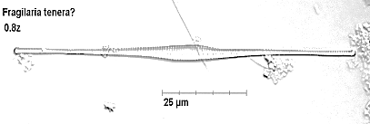
Climate tipping point: diatoms respond
14
NORTH RAFT
-4
12
P<0.01. df=28
10
-5
Temperature (C)
8
-6
Cyclotella taxa (%)
Diatoms (%)
6
4
-7
2
-8
0
-3
SPRUCE
6
P<0.01, df=34
-4
-5
4
Fragilaria tenera (%)
Annual Temperature (°C)
-6
2
-7
0
-8
-4
1945
1950
1955
1960
1965
1970
1975
1980
1985
1990
1995
2000
2005
2010
2015
Rühland et al. 2013. Proc. Roy. Soc. Lond. B
Notes:
SIMPLIFIED FIGURE OF RELATIONSHIP TO TEMPERATURE>>>BOTH PLANKTONIC INCREASES…

Slide 34

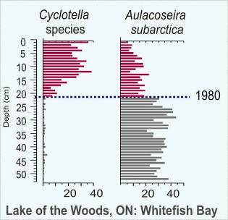
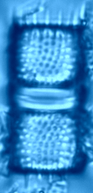
Lake of the Woods, Canada and USA - temperature
Whitefish Bay – Reference site
Annual Temperature
Cyclotella spp
Aulacoseira spp
4.5
50
4.0
40
3.5
30
3.0
20
2.5
2.0
10
1.5
R = 0.73
0
1.0
Annual Temperature (ºC)
Relative Abundance (%)
1900
1920
1940
1960
1980
2000
2020
4.5
60
4.0
50
3.5
3.0
40
2.5
30
2.0
1.5
20
R = - 0.65
1.0
1900
1920
1940
1960
1980
2000
2020
10
Rühland, Paterson, Smol 2008: Global Change Biology
Year AD

Slide 35
Phytoplankton declining in the oceans
There are consistent long-term trends since 1899 of
phytoplankton abundance (measured by chl) (Boyce et al. 2010).
sea surface temperatures (SST) were associated with declining chl in 8 of 10 ocean basins.
SST leads to shallower mixed layer depth (MLD) which limits nutrient supply in stratified tropical regions, but can benefit phytoplankton at high latitudes where growth is constrained by light availability and deep mixing.
Regional climate variability induces variation around the long-term trends and coastal processes such as land runoff can modify chl trends in nearshore waters.
Blue shading indicates 95% confidence intervals.
Boyce et al. 2010. Nature 446:591-596.

Slide 36
Is there a decline in marine phytoplankton?
McQuatters-Gollop et al. (2011) argue that Boyce et al. (2010) did not discuss contrary trends in phytoplankton abundance seen by the Continuous Plankton Recorder surveys in the North Atlantic over 8 decades (over 250,000 samples) and several other long-term observations in other ocean basins. They argue that Boyce et al. (2010) used correlations between secchi depth and chl which may be highly variable and which affect the trends in the early years of the record and that they also restricted data to the top 20m which does not take into account the high levels of chl found in the deep chlorophyll maximum. McQuatters-Gollop et al. argue that chl is actually increasing in the North Atlantic, especially since 1980.
McQuatters-Gollop et al. 2011. Nature 472: E6-E7. doi:10.1038/nature09950

Slide 37
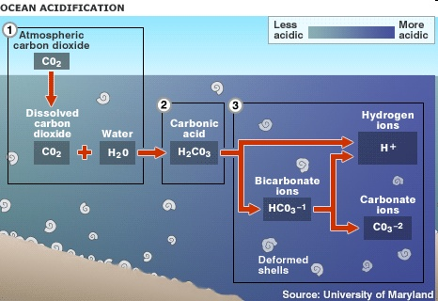
Ocean Acidification
Oceans have absorbed ca. one-third of the CO₂ produced by human activities which has acidified surface layers of the ocean (decrease of 0.02 pH units per decade over last 30 yrs and 0.1 pH units overall).
Resulted in substantial in carbonate ions that is unprecedented for millions of years.

Slide 38
A study of the effects of increasing CO₂ and
resulting ocean acidification on benthic algae on Palmyra Atoll examined the tradeoffs between enhanced photosynthesis and impaired biomineralization. Response varied by species, but the direction of response was consistent within groups.
Johnson et al. (2014), Contrasting effects of ocean acidification on tropical fleshy and calcareous algae. PeerJ 2:e411;DOI 10.7717/peerj.411

Slide 39
Growth was enhanced in fleshy macroalgae, calcification
was decreased in erect calcareous algae, and net dissolution occurred in crustose coralline algae. There was no consistent effect on algal photophysiology.
Results point to relative abundance of fleshy macroalgae on reefs and biomass of calcifying algae with ocean acidification.
Brown: fleshy; Green: erect calcareous; Red: crustose
Johnson et al. (2014) PeerJ 2:e411;DOI 10.7717/peerj.411

Slide 40
Crustose Coralline Algae
CCA are important marine calcifiers, especially on coral reefs
CCA consolidate the reef platform and induce settlement of larvae
CCA create habitats and promote biodiversity
CCA are important in biogeochemical cycling, especially carbon sequestration
CCA are particularly sensitive to acidification because they have high-magnesium calcite which is sensitive to dissolution
Net calcification, growth and primary production have all been shown to under CO₂ concentrations.
Ordonez et al. 2014 Biol. Bull. 226:255-268.

Slide 41
CCA cover showed a response to increasing ρCO₂ levels.
The density of individuals for some CCA taxa significantly with increased CO₂.
The number of reproductive individuals of Pneophyllum sp. by 80% between control and high CO₂ levels.
Effects on size structure of populations was variable and species specific.
Ordonez et al. 2014 Biol. Bull. 226:255-268.

Slide 42
Thick-crusted taxa had slower growth than thin-crusted taxa.
Changes is species composition of the CCA community may be because of space competition, variability in spore generation, variability in settlement success, and effects of increased CO₂ on physiology.
of acidification in the future could lead to species shifts from thick- to thin-crusted species which may make them unable to cement reefs enough to withstand high disturbance events.
Ordonez et al. 2014 Biol. Bull. 226:255-268.

Slide 43
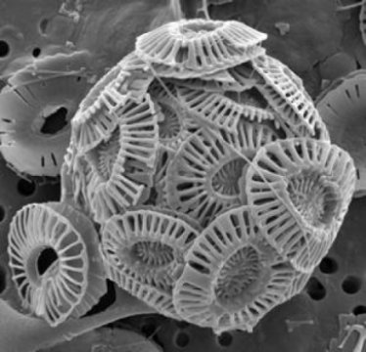
Coccolithophore calcification
Emiliana huxleyi increases calcification and net primary production under increased CO₂. There has been a 40% increase in coccolith mass over the past 220 years (Iglesias-Rodriguez et al. 2008. Science 320:336-340)
E. huxleyi is expanding its range into the polar oceans and appears to be more sensitive to temperature and salinity than to carbonate chemistry (Winter et al. 2014. J. Plank Res. 36: 316-325)
There was a progressive decrease in coccolithophore cell abundance and diversity along a natural calcite saturation gradient caused by CO₂ seeps (Ziveri et al. 2014. Biol Bull. 226:282-290)
Coccolithophores are important indicators of environmental conditions and their physiology and ecology deserve more study.

Slide 44
Kübler and Dudgeon (2015) modeled the rates of photosynthesis in response to ρCO₂,
temperature and their interaction under limiting and saturating photon flux densities
for red algae lacking carbon-concentrating mechanisms using published data.
Kübler and Dudgeon. 2015. PLoS ONE 10(7): e0132896. doi: 10.1371/journal.pone.0132806.

Slide 45
Major conclusions of the study:
Kübler and Dudgeon. 2015. PLoS ONE 10(7): e0132896. doi: 10.1371/journal.pone.0132806.

Slide 46
Effects of Climate Change on Global
Seaweed Communities
Adaptation, migration, reshuffling of communities, changes in herbivores.
Seaweeds lacking CCMs are more likely to be C-limited and thus more likely to benefit from increased CO₂. Non-calcifying seaweeds as a group will likely respond positively to increased CO₂.
Impacts on various life history stages are not well known, but increasing T has been linked to mortality of spores, gametophytes, eggs and sporophytes in Macrocystis pyrifera.
Some tropical species appear to have a limited scope for acclimation compared to temperate counterparts, presumably due to reduced environmental variability.
Harley et al. 2012. J. Phycol. 48:1064-1078.

Slide 47
Effects of Climate Change on Global
Seaweed Communities
Ecosystem responses- changes in productivity, diversity, resilience.
Population declines and even local extinctions have been documented at the warm end of species’ biogeographic ranges during warming.
Herbivores are key structuring agents in algal communities. Elevated temperatures may reduce herbivore defenses in algae and elevated CO₂ may increase C:N and reduce palatability.
Temperature may increase some herbivores, but heavily calcified ones (eg. sea urchins) may be decreased by ocean acidification.
Warming may make seaweeds more susceptible to bacterial disease.
Harley et al. 2012. J. Phycol. 48:1064-1078.

Slide 48
Coral Reefs
Coral reefs face challenges from temperatures and ocean acidification that are likely to lead to steep declines even by mid-century (Hoegh-Goldberg et al. 2007. Science 319:1737-1742; Baird and Maynard. 2008 Science 320: 315).
Coral symbionts are key to understanding the potential for such declines. Coral susceptibility to thermal bleaching- the heat-induced breakdown of their symbiosis with the dinoflagellate Symbiodinium- is dependent on different types within that genus which confer different levels of heat tolerance.
Changes in symbiont composition (symbiont shuffling) depends on the disturbance severity and the recovery environment (Cunning et al. 2015. Proc. R. Soc. B. 282:20141725).

Slide 49
Corals and Their Symbionts
Coral bleaching occurs when there is a breakdown of the symbiosis between cnidarian hosts and the resident Symbiodinium spp. Multiple mechanisms have been proposed.
Host cell apoptosis can contribute to cell death of symbionts without prior signaling from stressed or dying symbionts, similar to an immune response (Paxton et al. 2013. J. Exp. Biol. 216: 2813-1820).

Slide 50
In experiments on the coral Orbicula faveolata under experimental bleaching conditions, the proportion of heat tolerant symbionts dramatically following severe bleaching, especially in a warmer recovery environment, but tended to decrease if bleaching was less severe.
While the higher proportion of heat-tolerant symbionts bleaching resistance, the photochemical efficiency , suggesting that any change in community structure oppositely impacts performance and stress tolerance.
Even minor symbiont shuffling can adaptively benefit corals, but fitness effects of the resulting tradeoffs are hard to predict.
(Cunning et al. 2015. Proc. R. Soc. B. 282:20141725)

Slide 51
Corals and Their Symbionts
T in corals compromises photosynthesis by the symbionts, leading to an production of reactive oxygen species which causes a dissociation of the symbiont and host bleaching or death.
Symbionts can exert significant control of host pH. The photosynthetic activity of the symbionts plays a key role in regulating the cellular response of their host to external CO₂-driven acidification.
The number of Symbiodinium cells that a coral host contains may influence the cellular response of the host to acidification and its ability to calcify. (Gibbin et al. 2014. J. Exp. Biol. 217:1963-1069)

Slide 52
Large Benthic Foraminifera (LBFs)
Tropical LBFs contain algal symbionts: diatoms, dinoflagellates, rhodophytes. A general trend overall on holobiont growth was observed across most LBFs in response to T and pH. The only exception was a species that had a diatom symbiont. (Doo et al. 2014. Biol. Bull. 226:169-186)
Porcelaneous taxa calcification under lower pH conditions and are not nutritionally dependent on their dinoflagellate symbionts. Calcification of hyaline taxa may be by ocean acidification conditions because they are dependent on their diatom symbiont photosynthesis. There is a porcelaneous LBF, Alveolinella, that harbors diatom symbionts which deserves study. (Doo et al. 2014. Biol. Bull. 226:169-186)
The majority of LBF species exhibited health in response to T.
LBFs contribute ca 5% to reef-scale carbonate budgets, especially on reef flats (Langer 2008. PLoS ONE 8: e54443)

Slide 53
Acidification Impacts in the Southern Ocean
Strong evidence that light intensities strongly modify the effects of acidification on phytoplankton.
Chaetoceros debilis was grown at 390 and 1000 µatm ρCO₂ under constant or dynamic light condition.
Dynamic light growth and strongly altered the effects of acidification on primary production, being significantly under dynamic light at elevated ρCO₂.
There were changes in cellular energy balance: energy transfer efficiency from photochemistry to biomass production was drastically under dynamic light at ρCO₂.
Because diatoms are major players in exporting C to depth, in their abundance has biogeochemical significance.
Hoppe et al. 2015. New Phytologist 207:159-171

Slide 54
What can an Alga Do?
Acclimate (metabolic changes)
Adapt (genetic changes)
Migrate
Change symbiotic associations
Reshuffle communities
Change responses to loss processes (sinking,
herbivores, cell death)

Slide 55
Why should we care?
Algae produce oxygen- about half of the total every year.
Algae are at the base of the food web in aquatic ecosystems. They may be declining and changes in community structure can affect food webs
Algae are important symbionts in many organisms, especially those associated with coral reefs
Algae can form harmful algal blooms and warming climates increase frequency and duration of blooms
Algae form increasing ‘dead zones’ in coastal environments
Algae are just plain interesting!

Slide 56
It’s the only planet we have
Let’s take care of it!
Thank you for your attention

